Slide 1
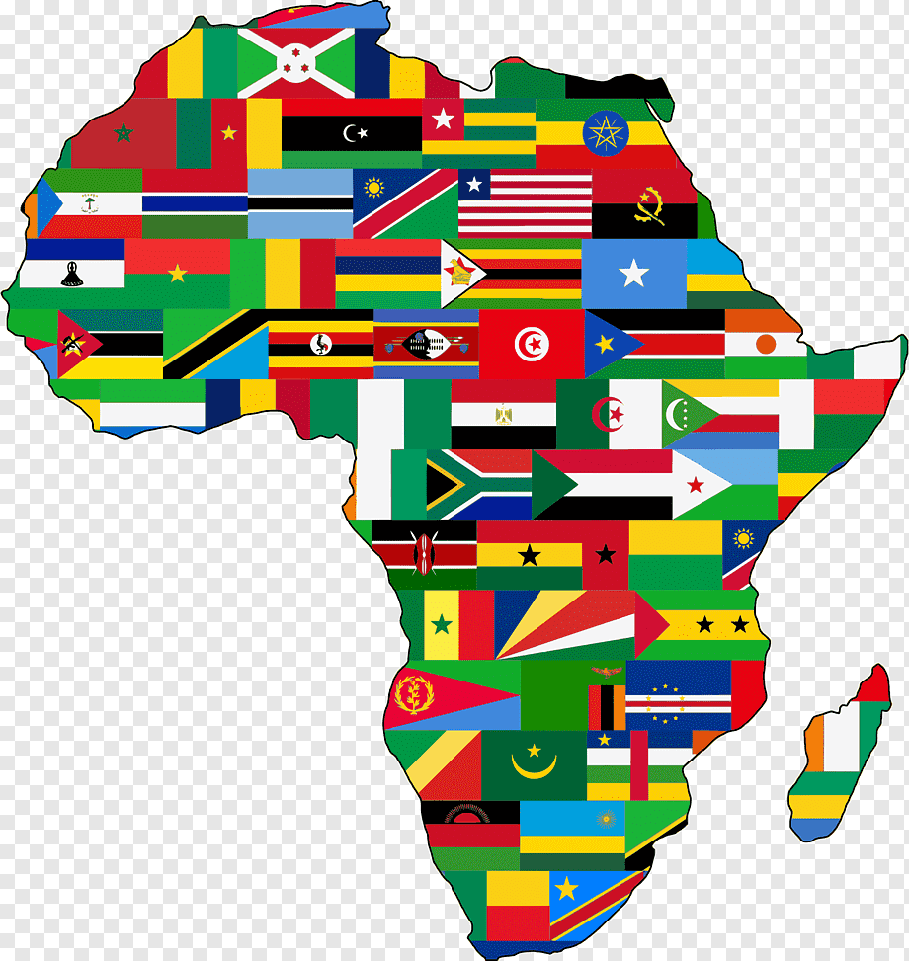
Culture of AFRICA
K.Lokesh

Slide 2


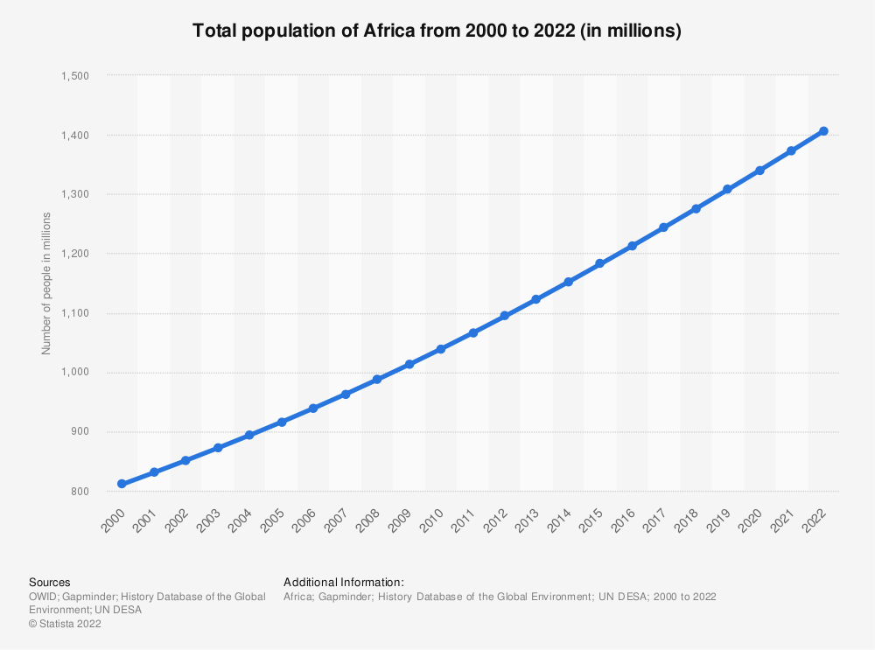
Population
54 countries
1.4 billion
2nd Biggest

Slide 3

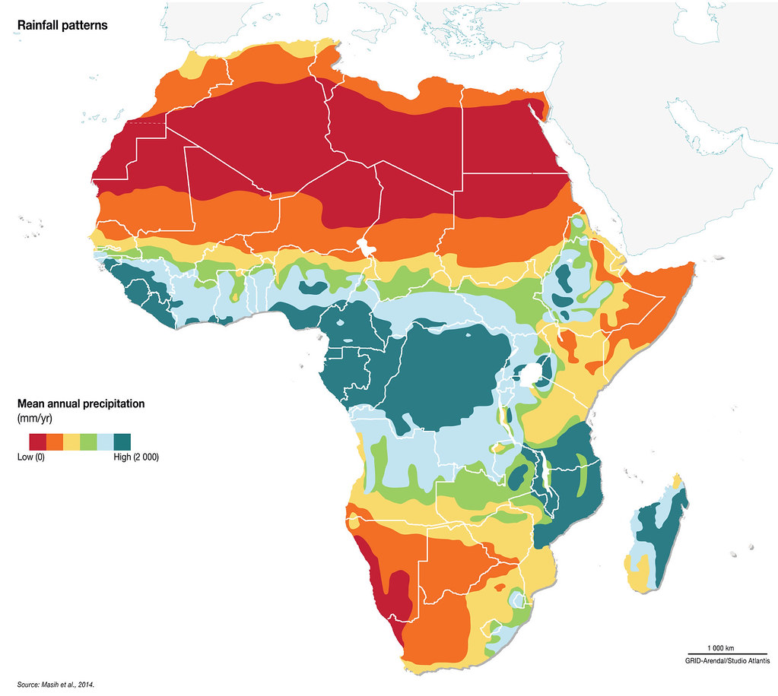
Climate

Slide 4

Christianity and Islam

Slide 5

Christianity and Islam
3000 Tribes

Slide 6
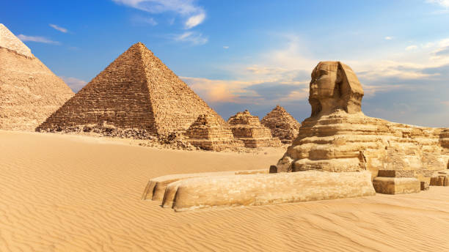
Famous for
Egypt
Sahara Desert

Slide 7

Famous for
Egypt
Sahara Desert

Slide 8
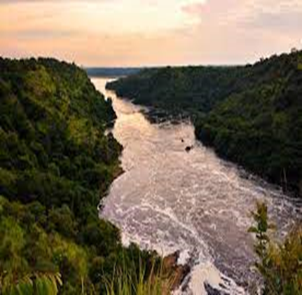
Nile River

Slide 9
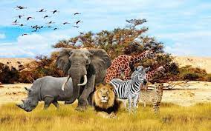
Wild Life

Slide 10
Thank you

